Slide 1

Making Legal Contract Smart Using Blockchain Technology
Presenting
1.Shruti Gatkal
2. Abhijit Mahajan
3. Pournima Borole
4. Anushka Kawale
Project Mentor
Prof. Neha Rai (Ma’am)

Slide 2
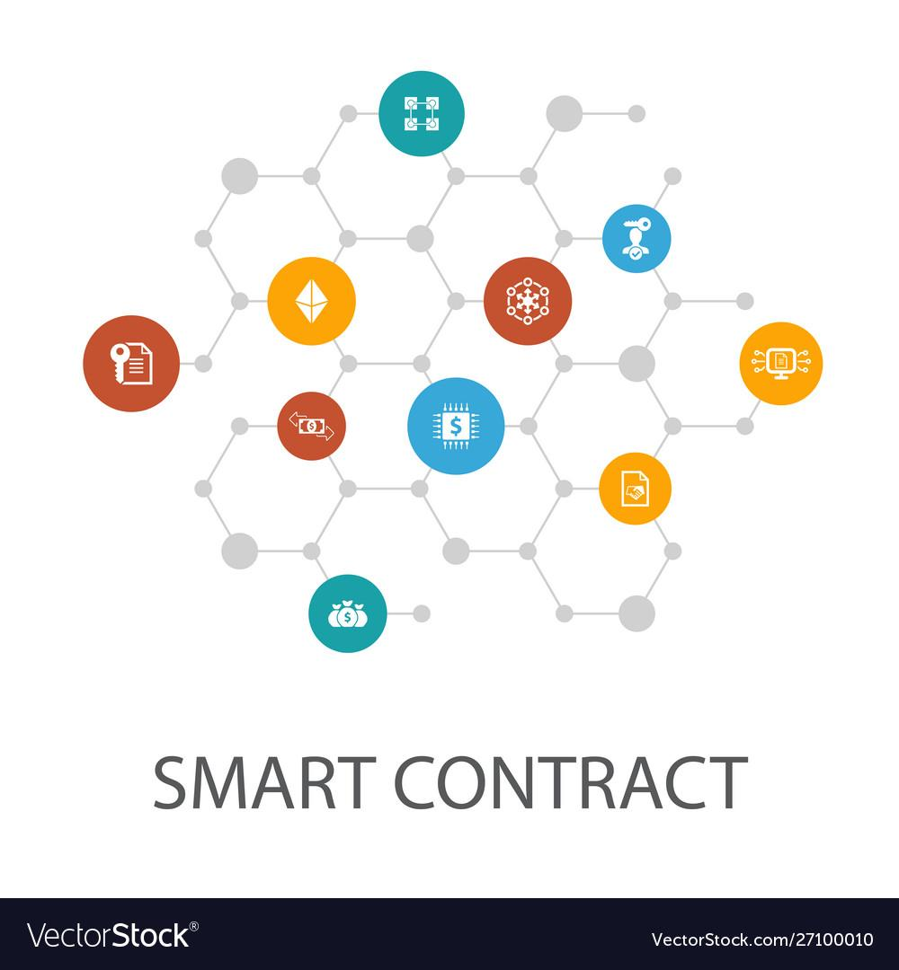
Problem Statement
To achieve reliable & secure generation of Legal Contract’s using Smart Contract concept following the Indian Constitution Act & Law.
Also deploy contract on Ethereum blockchain to make it immutable.

Slide 3
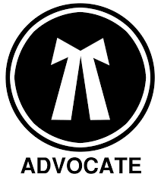

Introduction
To make any legal contract in India, we need to hire a lawyer & spent money on that.
we are dependent on that third party such as Lawyers Notari etc. for the entire process.
To overcome this problem & to make it safer as well as non-repudiable we are proposing a Web3 system.
System provides a platform for the parties to make a legal contract using a smart contract & deploy it on blockchain .
This system makes legal contracting decentralized, middle-man free as well paper-less that is fully digital and fast.

Slide 4

Blockchain
“Blockchain Technology” is an advanced database
mechanism that allows transparent information
sharing within the network.
Blockchain is immutable, shared ledger that facilitates the process of recording transactions, and keeping the track of assets in a business network.
An asset can be tangible (a house, car, cash, land) or intangible (intellectual property, patents, copyrights, branding). Virtually anything of value can be tracked and traded on a blockchain network, reducing risk and cutting costs for all involved.

Slide 5

Research Gap Identified
Currently there are some application which provide smart contract facility but to use user required knowledge of technical terms & tolls, which does not make it convenient to all people.
“AccordProject” named web-application provide facility to generate standard template of smart contract & It also provide custom smart contract writing facility.
But it is not based on Indian Constitution Act & Law, so these contract are not approved by government.
Also it required technical knowledge to use it .
https://accordproject.org

Slide 6
Objective
To satisfy common contractual conditions such as integrity,non-repudiation, availability and even enforcement.
To provide a platform to user to make legal contracts which are smart as well legal in india .
To minimize exceptions both malicious and accidental, and minimize the need for trusted intermediaries.
To reduce third party dependency and expenditure.
To merge smart contract efficiency and blockchain security into Indian government and constitution act.

Slide 7
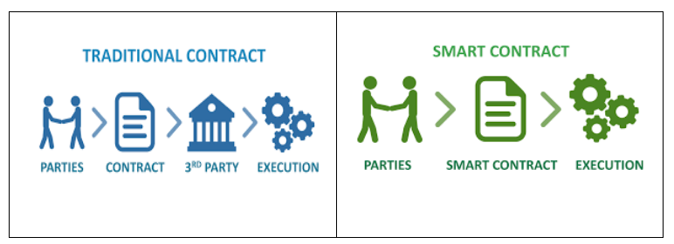
Conventional Contract VS Smart Contract

Slide 8
Contract Types
01
02
03
Registry
Rental Contracts
Business contracts
Marriage Registry
Divorce Registry
.
Home Rental Contract
Shop Rental Contract
Franchise Contract
supply Contract
Privacy Contract

Slide 9
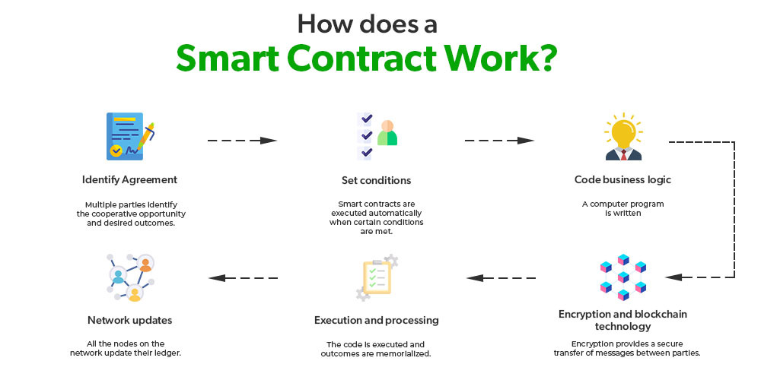
How Smart Contract Works ?

Slide 10


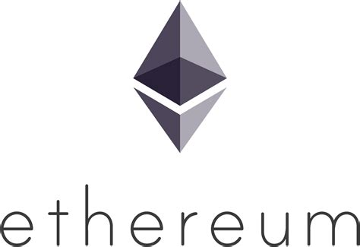
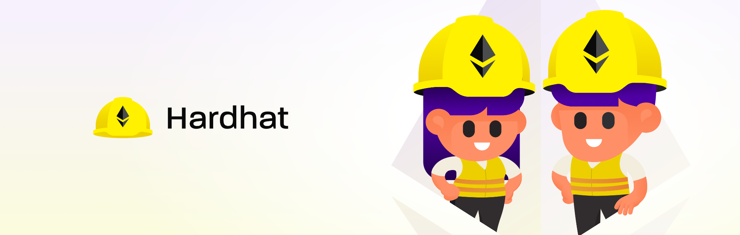
Technology & Tools
Ethereum Blockchain
Solidity
HardHat
Metamask
React JS

Slide 11
TECHNOLOGY USED - 1
SOLIDITY - Solidity is a contract oriented, statically typed and domain specific programming language for writing smart contracts on the Ethereum blockchain. Solidity is considered as one of the most important tools for developers building applications on the Ethereum network because it allows them to not just write their own contracts easily and quickly, but also interact with the Ethereum Virtual Machine(EVM).
HARDHAT - Hardhat is an open source development environment for building and testing smart contracts on the Ethereum blockchain. It provides a set of tools and plugins that can be used to streamline the development process and automate common tasks, such as compiling contracts, deploying them to the blockchain and running tests. Truffle is equivalent to blockchain. But we are using Hardhat for various reasons like better performance, better support for TypeScript and improved testing framework.

Slide 12
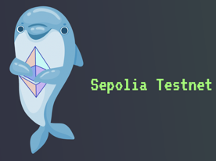
TECHNOLOGY USED - 2
SEPOLIA -
Sepolia is the primary testnet recommended by Ethereum
for dapp development. The testnet utilizes a permissioned
set of validators and is relatively new, suggesting that its state and history are both relatively small. Consequently, running nodes require less storage, and the network can sync quickly. As a result, you can quickly spin up a node if you want to interact directly with the network. Three key Sepolia takeaways :
Fast syncing
A closed set of validators
Relatively new testnet hosting fewer apps than other networks.

Slide 13
TECHNOLOGY USED - 3
REACTJS - ReactJS is a popular frontend JavaScript library used for building user interfaces. It provides a powerful and flexible way to build complex user interfaces,and it is used to build decentralized applications (DApps) that interact with smart contracts on the blockchain. When building Dapps with the ReactJS, developers typically use a library like Web3.js to interact with the Ethereum blockchain. Web3.js is a JavaScript library that provides a simple and easy-to-use interface for interacting with smart contracts on Ethereum blockchain.
METAMASK (An Ethereum Wallet in the browser) - MetaMask is an extension for accessing Ethereum enabled distributed applications, or “Dapps” in the Browser. The extension ijects the Ethereum web3 API into every website’s javascript context, so that dapps can read from the blockchain. Because of its adds functionality to the normal browser context, MetaMask requires permission to read and write to the webpage.

Slide 14
Future Scope
Blockchain is a emerging technology which have tremendous future scope :
Expanding our framework to support each type of statement and input. These upgrades would allow our framework to represent more such agreements.
Also application have scope to secure & monitor all legal & government deals with huge amount.
The future of digital transactions, business deals, communications, and modern life will likely carry the footmark of smart contracts.
This blockchain-based technology is unwrapped opportunities not only for legal professionals but for graduates of blockchain degree programs as well with consensus mechanisms.

Slide 15
Conclusion
Web3 System to make legal contract without third party involvement.
User convenient. No need of domain knowledge.
Ethereum Blockchain
will be used.
Obey of Indian Constitution Act & Law..

Slide 16
THANK YOU
Q & A

